Slide 1
MACHINE LEARNING
Supervised Approaches
Team: A. Bit-Monnot, E. Chanthery, M-J. Huguet, P. Leleux, M. Siala
https://moodle.insa-toulouse.fr/course/view.php?id=1790

Slide 2
Topics planned
Volume: 6 CM – 3 TP
Introduction on AI and supervised learning (E. Chanthery)
Learning process and assessment
A brief focus on a basic tool for learning: Gradient descent
Learning using Artificial Neural Networks (P. Leleux)
Learning using Interpretable Machine Learning Models (M. Siala)
Practical sessions
Artificial Neural Networks
Decision Trees
Assessment: 1 quizz on moodle, 1 report on labs

Slide 3
At the end of this module, the student will have understood and be able to explain:
The characteristics of supervised learning problems (data sets, classification / regression, learning process, evaluation of learning models)
the main basic methods and algorithms to deal with these problems (neural networks and interpretable models)

Slide 4
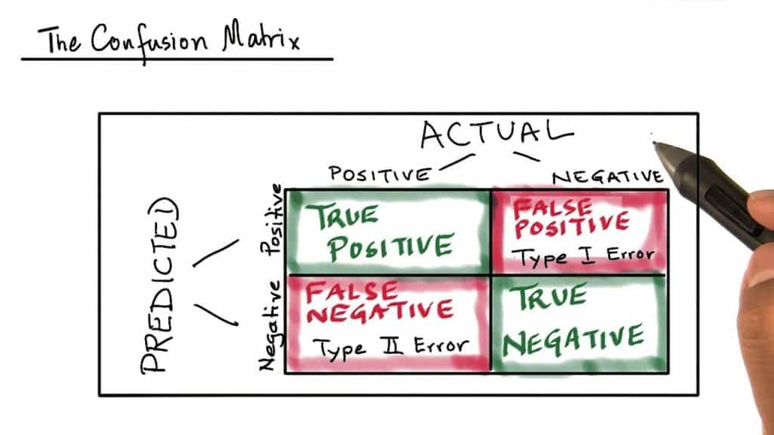
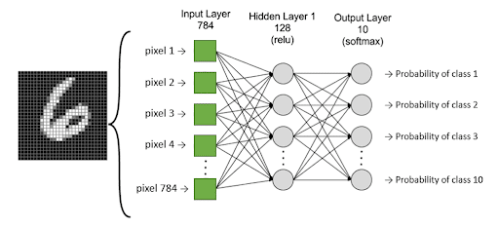
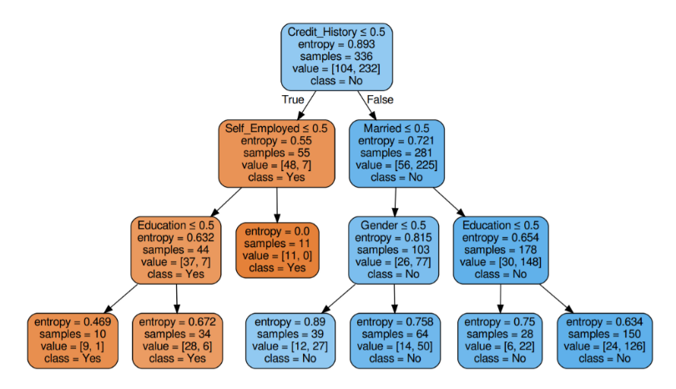
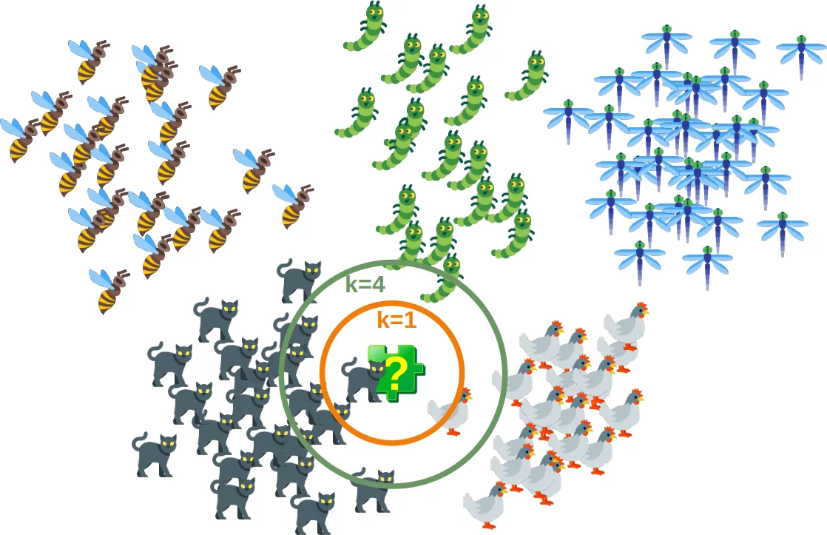
A short teaser: what you will be able to do after this course
set up a learning process
use the algorithms implemented in existing libraries
adapt and develop your own algorithms
present and explain the results of learning algorithms
program ML in Python

Slide 5
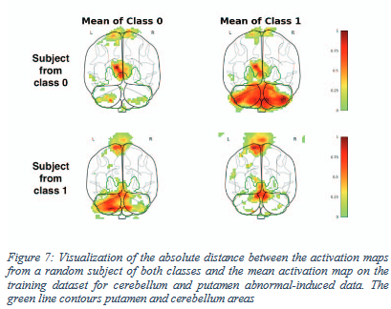
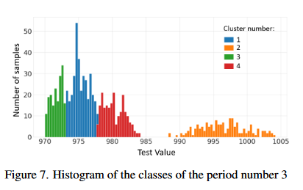
Our research interests
Data-based diagnosis and prognosis
Model learning for health monitoring
Alexandre Gaffet, et al. Data-Driven Capability-based Health Monitoring Method for Automotive Manufacturing. EUROPEAN CONFERENCE OF THE PROGNOSTICS AND HEALTH MANAGEMENT SOCIETY ( PHM Europe), PHM society, Jun 2021, Turin (virtual), Italy
Villain, Edouard, et al. "Visual interpretation of CNN decision-making process using Simulated Brain MRI." 2021 IEEE 34th International Symposium on Computer-Based Medical Systems (CBMS). IEEE, 2021.
Interpretable methods
Decision trees
rules
Combinatory methods (MaxSAT) for interpretable models
Hu, Hao, et al. "Learning optimal decision trees with maxsat and its integration in adaboost." IJCAI-PRICAI 2020, 29th International Joint Conference on Artificial Intelligence and the 17th Pacific Rim International Conference on Artificial Intelligence. 2020.
Combinatory problems (Branch and Bound) for interpretable fair models
Error=0,183
Unf=0,066
FairCORELS, an Open-Source Library for Learning Fair Rule Lists. U. Aivodji, J. Ferry, S. Gambs, M-J. Huguet, M. Siala - ACM International Conference on Information and Knowledge Management (CIKM), November 1-5, 2021
Error=0,208
Unf=0,0036

Slide 6
Introduction on AI and Supervised Learning

Slide 7
What is AI?
What is Machine Learning? What is Supervised Learning?

Slide 8
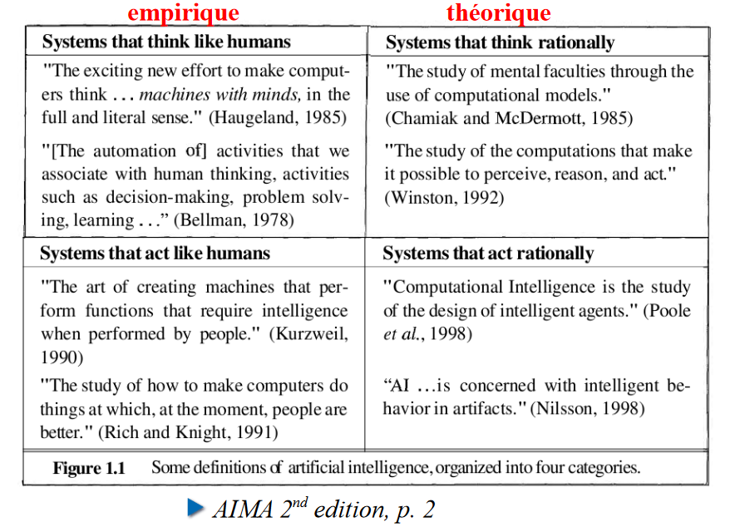
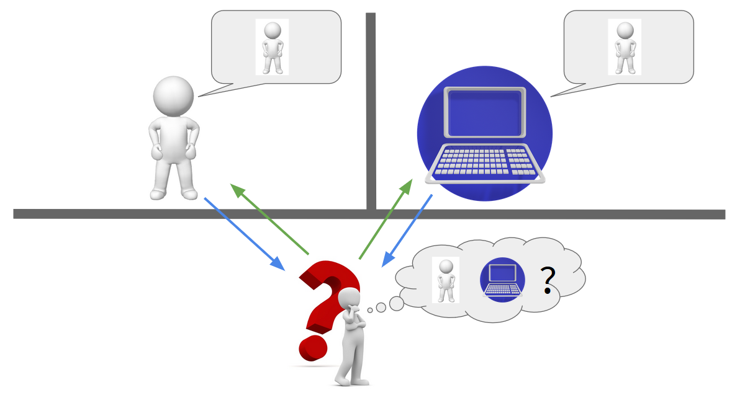
What is AI?
1950’s : idea : do not define AI, but test it → Turing test intended to test whether or not a machine has the ability to imitate human intelligence
1956: AI as a scientific field (conference at Darmouth College)
"The main components of an AI system should be knowledge, reasoning, natural language understanding and learning.” A. Turing

Slide 9
Traditional programming paradigm vs ML
The traditional programing paradigm
program
data
outputs
Machine Learning
data
outputs
program
“Machine Learning is the field of study that gives computers the ability to learn without being explicitly programmed”. Arthur Samuel (1959)

Slide 10
The connection between fields: AI in your cursus
STATISTICS
Data analysis
OPTIMIZATION
Constraint satisfaction and optimization
ARTIFICIAL INTELLIGENCE
MACHINE LEARNING
AUTOMATIC CONTROL
Behavior and control, decision
VISION

Slide 11
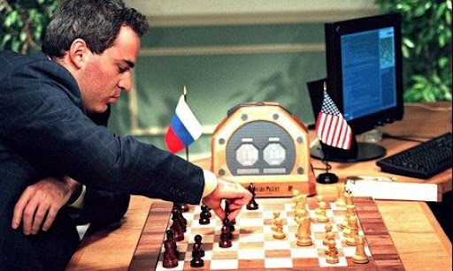
AI and Machine Learning
Artificial Intelligence
Machine Learning
Natural Language Processing (NLP)
Reasoning
Planning
Knowledge Representation and Reasoning
Vision
Motion and Manipulation
Multiagent Systems
General Intelligence
Supervised Learning
Semi-supervised Learning
Unsupervised Learning
Reinforcement Learning
Transfert Learning
Deep Learning
Machine Learning is a subset of Artificial Intelligence. The term Artificial Intelligence is often used wrongly (buzzword in the sense of global intelligence).
Not all AI systems involve machine learning: ex Deep Blue executes the alpha-beta search algorithm: it is not ML

Slide 12
Artificial Intelligence
Neural Networks
Deep Learning
Machine Learning
Automated Programming
Knowledge Representation
Expert Systems
Intelligent Robotics
K-means clustering
Principal Component Analysis (PCA)
Planning and Scheduling
Decision Trees
Automatic Reasoning
Visual Perception
K-Nearest neighbors (KNN)
Anomaly detection
Speech recognition
Random Forest
Autoencoders
Ensemble methods
Natural Langage Processing (NLP)
Support vector machines (SVM)
Problem solving & Search strategies
Naïve Bayes classification
Linear/Logistic regression
Recurrent Neural Networks (RNN)
Modular Neural networks
Reinforcement Learning
Multilayer
Perceptrons (MLP)
Convolutional Neural Networks (CNN)
Long Short-term Memoru networks (LSTM)
Recurrent Neural Networks (RNN)
Deep Reinforcement Learning
Deep Autoencoders
Generative Adversarial Networks (GAN)
Deep belief networks (DBN)

Slide 13
Examples
Artificial Intelligence
Machine Learning
Deep Learning
A non-biological system that is intelligent through rules
Algorithms that learn models/representations/
Rules automatically from data/examples
Algorithms that parameterize multilayer neural networks that then learn to recognize classes with multiple layers of abstraction

Slide 14
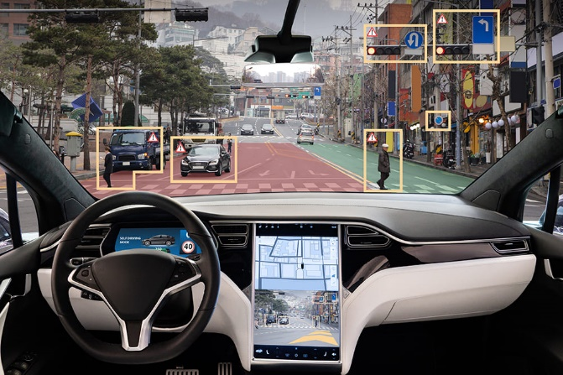
Some applications of Machine learning
Diagnostic support systems
High stake decision-making systems
Games
Pattern recognition: email spam detection, fingerprint/face detection and matching
System control: self-driving cars (Uber, Tesla), automatic control, sort (post office) Automatic translation (initiated during the war) (google translate, deepl)
Voice synthesizer, smart assistants (Apple Siri, Amazon Alexa…)
Finance/industry: cost of living forecasting, stock predictions
Sports prediction, product recommendation (Netflix, Amazon…)
Drug design, medical diagnoses (EEC and ECG analysis)
…

Slide 15
The broad categories of ML
Machine Learning
Supervised Learning
Semi-supervised Learning
Unsupervised Learning
Reinforcement Learning
Transfer Learning
Deep Learning

Slide 16
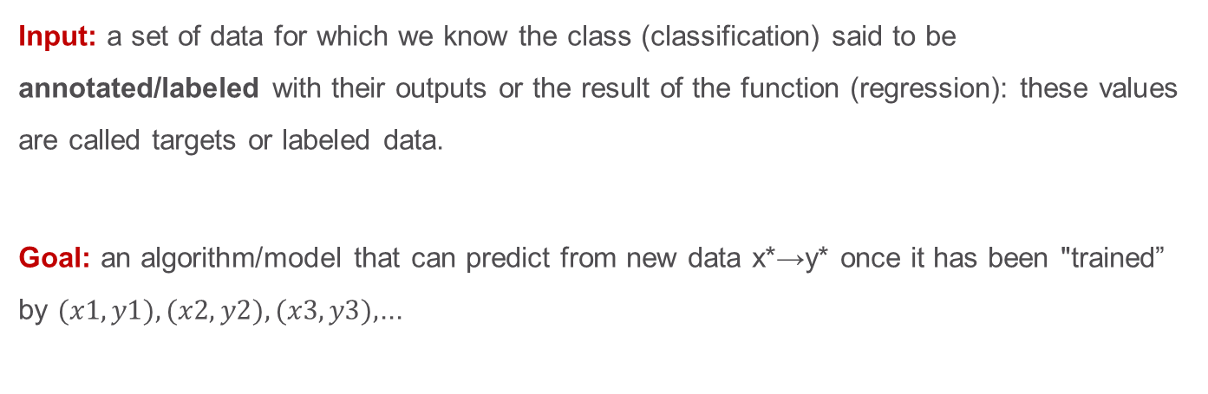
Supervised Learning
Supervised Learning
Labeled data
Direct feedback
Predict outcome/future
Source: Raschka and Mirjalily (2019). Python Machine Learning, 3rd Edition
Input: a set of data for which we know the class (classification) said to be annotated/labeled with their outputs or the result of the function (regression): these values are called targets or labeled data.
Goal: an algorithm/model that can predict from new data x*→y* once it has been "trained” by $(x1, y1),(x2, y2),(x3, y3),$...

Slide 17
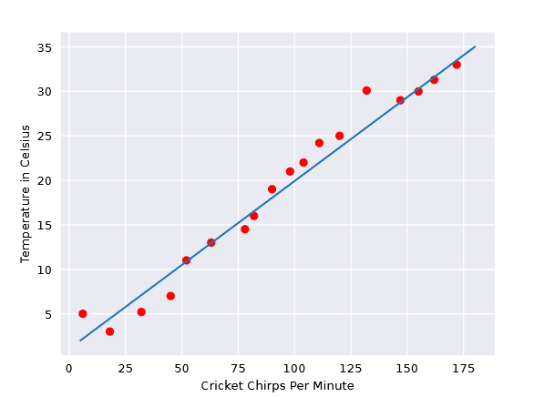
Supervised Learning (1): regression
Target (dependent variable, output)
Feature (input, observation)
To infer (predict) the temperature for a new chirps-per-minute value, just substitute the value into the blue model.
Source: https://developers.google.com/machine-learning/crash-course/descending-into-ml/linear-regression

Slide 18
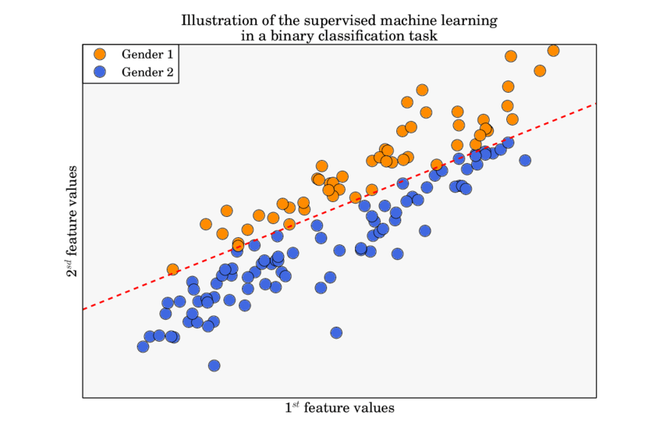
Supervised Learning (2): classification
Linear decision boundary
Kawala, François. (2015). Activity prediction in social-networks.

Slide 19
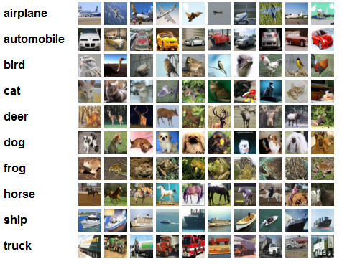
Supervised Learning (3): classification
Input data: labeled images
Target: photo category

Slide 20
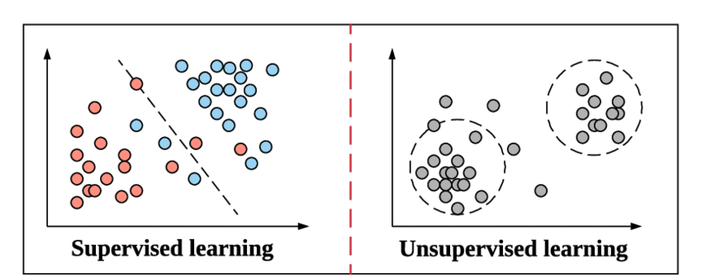
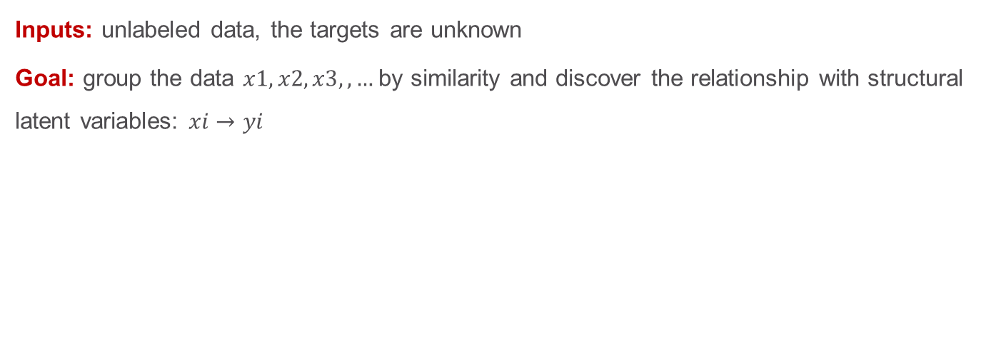
Unsupervised Learning
Unsupervised Learning
No labels/targets
No feedback
Find hidden structure in data
(Won’t cover this in this course)
But in 5th year! (SIEC)
Source: Raschka and Mirjalily (2019). Python Machine Learning, 3rd Edition
Inputs: unlabeled data, the targets are unknown
Goal: group the data $x1,x2,x3,,…$by similarity and discover the relationship with structural latent variables: $xi→yi$

Slide 21

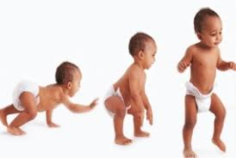
(Won’t cover this in this course)
Semisupervised Learning
Some training examples contain outputs, but some do not
Use the labeled training subset to label the unlabeled portion of the training set → model training
A recent development, promising research trend in deep learning
Useful if pre-trained models for transfer learning are not available
Reinforcement Learning
Based on an experience/reward cycle
Decision process that improves performance with each iteration, reward system
The “dopamine” effect

Slide 22
Data

Slide 23
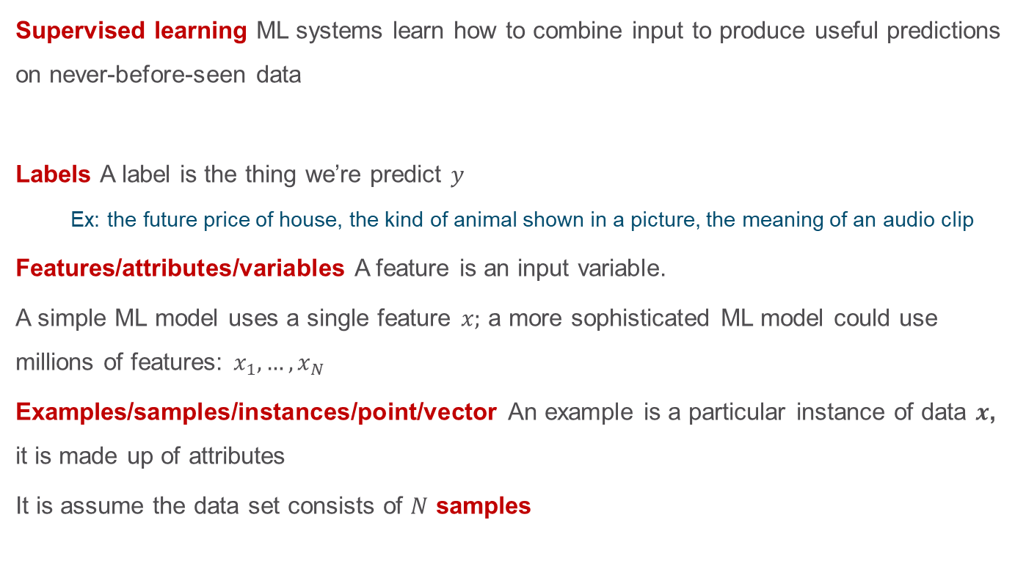
Key ML terminology
Supervised learning ML systems learn how to combine input to produce useful predictions on never-before-seen data
Labels A label is the thing we’re predict $y$
Ex: the future price of house, the kind of animal shown in a picture, the meaning of an audio clip
Features/attributes/variables A feature is an input variable.
A simple ML model uses a single feature $x;$ a more sophisticated ML model could use millions of features: $x_{1},…, x_{N}$
Examples/samples/instances/point/vector An example is a particular instance of data $x$, it is made up of attributes
It is assume the data set consists of $N$ samples

Slide 24
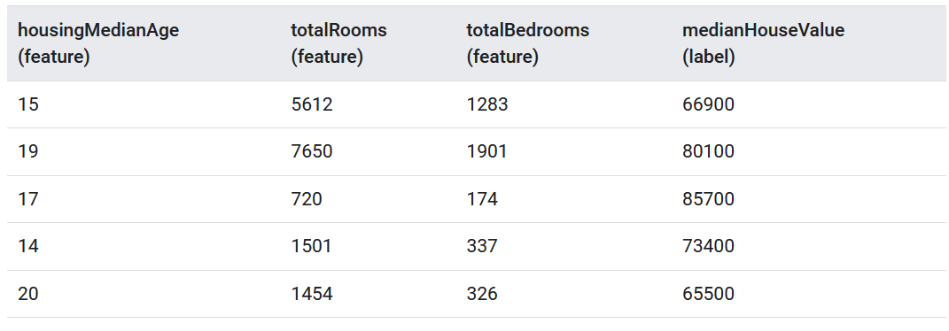
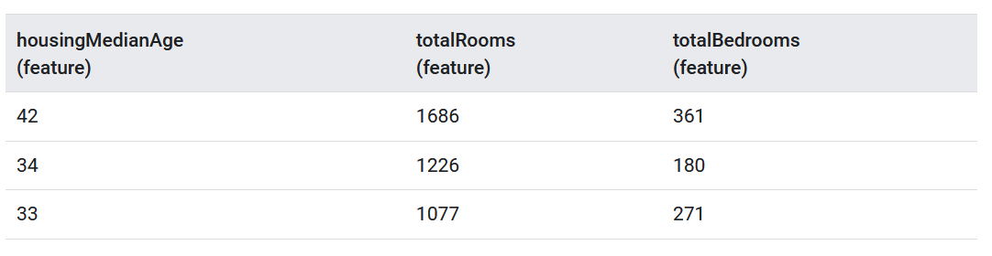
Examples
Labeled examples from a data set containing information about housing prices in California
Unlabeled examples about housing prices in California

Slide 25
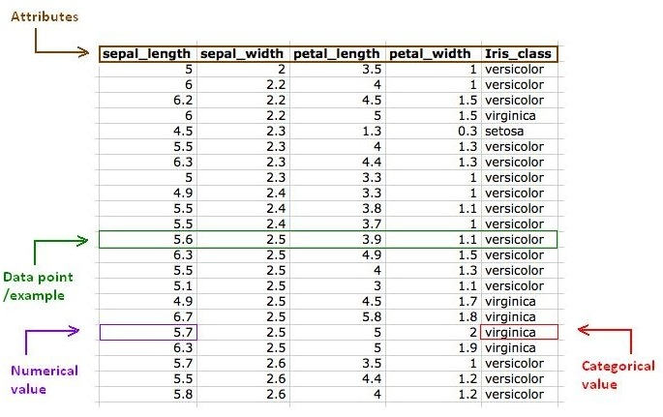
iquiz
What does the green line represent?
Attributes
One sample
Several samples

Slide 26
iquizz
Suppose you want to developed a supervised ML model to predict whether a given email is “spam” or “not spam”. Which of the following statements is true?
Word in the subject header will make good labels
Unlabeled example will be used to train the model
Emails not marked as “spam” or “not spam” are unlabeled examples
By hypothesis, all the labels applied to examples are reliable

Slide 27
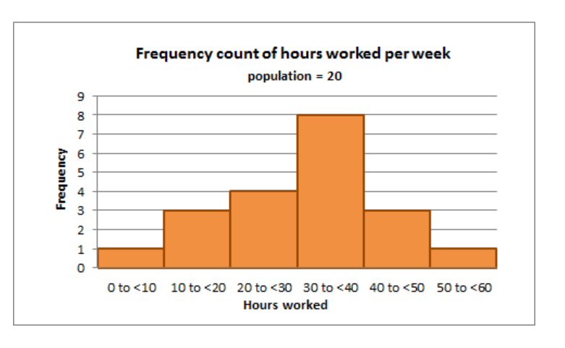
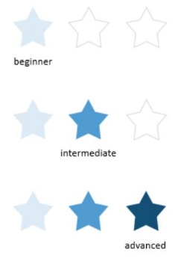
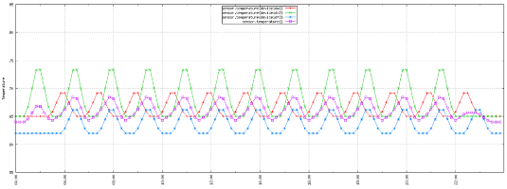
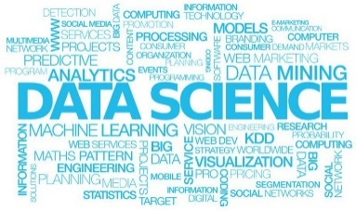
Basic types of data
Quantitative/Numerical data
Qualitative/Categorical data
Time series data
Text
Can be counted, data are exact numbers, but they are not ordered
Ex: house prices, speed, frequency
Can be continuous (temperature, speed) or discrete/binary (number of cycles)
Can’t be counted, represents characteristics
Ex: gender, color, team
Can take numerical values that do not have mathematical meaning
could the class label
A sequence of numbers collected at regular intervals over some period of time
Ex: the voltage value during 10 sec
Values are ordered : there is a first data point and a last data point collected
Can be nominal (not ordered, ex: gender, color) or ordinal (small<medium<large)
Video
Audio
Image
Special mention for time and interval
Tabular data
https://medium.com/ml-research-lab/chapter-2-data-and-its-different-types-3dfebcbb4dbe

Slide 28
Other classification for quantitative data
Transactional logs: record a specific event.
Ex: record an open command, plus date and time
Attribute data: contain snapshots of information.
Ex: user demographics
Aggregate statistics: create an attribute from multiple transactional logs.
Ex: average of a signal value

Slide 29
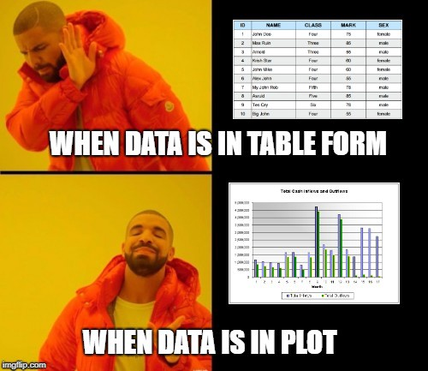
Data vizualization
Why visualization? For understandability, for intuition, for
explainability
How? → there are very good packages for visualization
Common languages: R (more a statistical language), Python (widely used for ML and data science)
Packages: scikit, matplotlib, seaborn…
How to work with big dimensionality? Dimensionality reduction techniques (PCA, TSNE, LDA…)
https://towardsdatascience.com/data-visualization-for-machine-learning-and-data-science-a45178970be7
Notes:
PCA : analyse en composante principale – TSNE : neighbor embedding – LDA: linear discriminant analysis

Slide 30
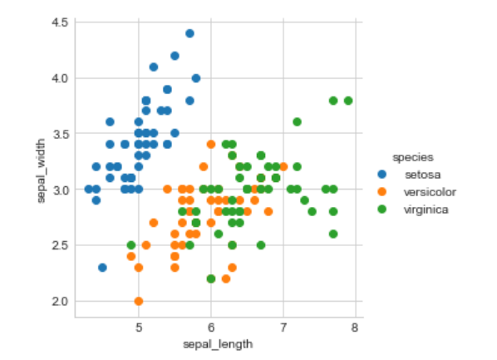
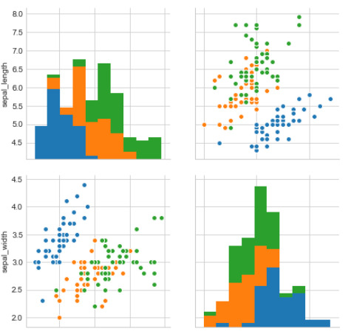
Different types of analysis
Univariate analysis: plot a single feature to analyze its properties
Box plot
Violin plot
Distribution plot
Joint plot
Bivariate analysis: compare exactly 2 features
Scatter plot
Bar chart
Line plot
Multivariate analysis: compare more than 2 features
Pair plot: a nxn figure with
Scatter plot
Pair plot
https://towardsdatascience.com/data-visualization-for-machine-learning-and-data-science-a45178970be7

Slide 31
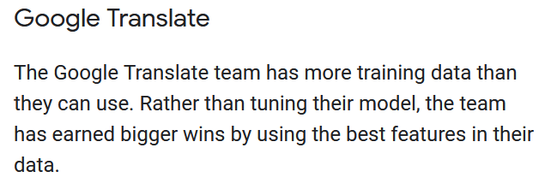
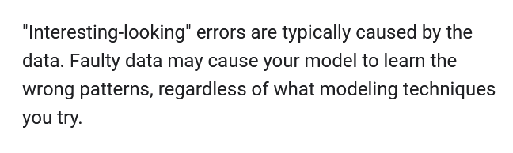
Quality and size of the data sets
The quality and size of the data set matter much more than which shiny algorithm you use
https://developers.google.com/machine-learning/data-prep

Slide 32
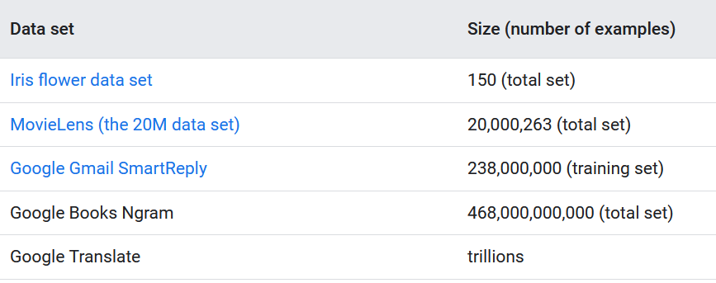
The size of the data set
As a rough rule of thumb, your model should train on at least an order of magnitude more examples than trainable parameters.
What is “a lot” of data?
Amount of data depends on the complexity of the “true” function
If the true function is simple, a small amount of data is enough for a learning algorithm with high bias and low variance
If the true function is complex, a very large amount of data will be necessary and the algorithm should be with low bias and high variance

Slide 33
Quality of a data set
Rule 1: be pragmatic → a quality set is one that accomplishes its intended task
3 quality criteria:
Reliability
Feature representation
Minimizing skew
Notes:
Fiabilité
Skew=biais

Slide 34
Reliability (fiabilité)
Represents how much you can trust the data
Depends on the label errors (ex: if the data are labeled by humans → mistakes)
Depends on the noise on the features (ex: GPS measurements)
Depends if the data are appropriate for the problem (ex: bias)
Examples:
Omitted values in a data base
Duplicated examples
Bad labels
Bad feature values (sensor failures for example)

Slide 35
iquizz
In your machine learning project, how much time will you typically spend on data preparation and transformation?
Less than half time of the project
More than half time of the project

Slide 36
Feature representation
How is data shown to the model?
Should you normalize numeric values? Are the features scaled to similar ranges?
Methods that employs distance are sensitive to this → SVM, KNN perform poorly
How should you handle outliers?
Is there some redundancy/interaction in the data or not ?
→ If each of the features makes an independent contribution to the output
linear regression, SVM, naive Bayes and distance-based algorithms (KNN) perform well
→ If there are complex interactions among features
Linear regression, distance based methods will perform poorly, decision trees and neural networks work better

Slide 37
De quand date l’Intelligence Artificielle?
Des 10 dernières années
Des années 2000
Des années 70
Des années 50

Slide 38
Quelle approche d'apprentissage est utilisée lorsque l'algorithme s'améliore en fonction de son expérience antérieure?
1) Apprentissage supervisé 2) Apprentissage non supervisé 3) Apprentissage par renforcement 4) Apprentissage semi-supervisé

Slide 39
Quelle est la différence entre l'apprentissage supervisé et l'apprentissage non supervisé?
1) La présence ou l'absence d'un modèle 2) La présence ou l'absence d'étiquettes dans les données d'entraînement 3) La complexité des algorithmes utilisés 4) Le nombre de layers dans le modèle

Slide 40
Minimizing skew (distorsion): training vs prediction
Sometimes we get great results offline and very bad results online
It is a training/serving skew (distorsion apprentissage/reconnaissance)
Always consider what data is available to your model at prediction time. During training, use only the features that you'll have available in serving, and make sure your training set is representative of your serving traffic.
The more closely the training task matches the prediction task, the better the ML system will perform
Notes:
distorsion

Slide 41
Prediction data sources: online vs offline
Online: latency is concern, the system must generate input quickly
Offline: no computation restrictions

Slide 42
Define a ML problem and propose a solution
Construct the data set
Transform data
Train a model
Use the model to make predictions
Data preparation
“Garbage in, garbage out”
Collect raw data
Identify feature and label sources
Select sampling strategy
Split the data
Explore and clean the data set
Feature engineering
Caution:
this process is a typical process, not ideal for every process
The process is not always sequential (more data needed, modification of the feature set even after training)
https://developers.google.com/machine-learning/data-prep

Slide 43
The ML workflow

Slide 44


The Machine Learning Workflow
A machine learning problem has different specific elements:
The data (training data but also new data)
The specific task to be accomplished (predict, recommend, decide something, etc.)
The learning algorithm itself
The error analysis (or measurement of the model performance)
❶ Training
80%
Learning algorithm
Parameter changes
Training Dataset
Dataset
Labeled data
Quality metrics
20%
Model
Predicted output
labels
Test Dataset
New data
Unlabeled data
❷ Inference

Slide 45
Model validation
Suppose we must choose between two possible ways to fit some data. How do we choose between them?
Simple solution: try to fit the data as closely as possible.
Problem: the generalization to new measurements
→ Solution: evaluate models by testing them on a new data set (the “test set”), distinct from the training set. Model validation: estimating the reliability of a model
Cross-validation is a method for estimating the reliability of a model based on a sampling technique.
3 methods:
"testset validation" or "hold-out validation"
"k-fold cross-validation”
"leave-one-out cross-validation" (LOOCV).

Slide 46
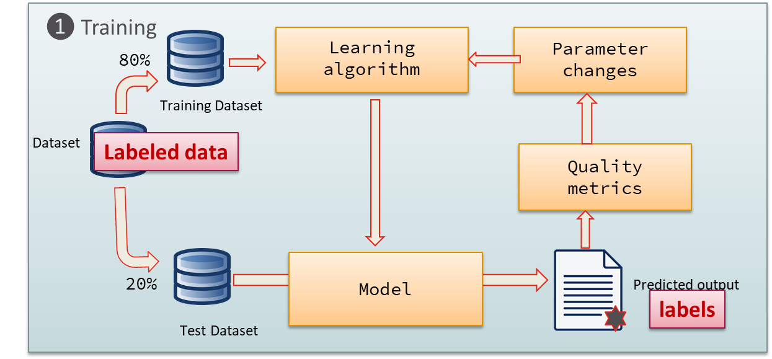
“testset validation” or “hold-out validation”
The simplest method:
Partition the data randomly into a training set (usually > 60%) and a validation set (hold-out set)
For a set of chosen values for hyperparameters, learn a model on the training set
Compute the model’s error on the validation set (see metrics)
Pick the best hyperparameter which has the smallest validation set error and retrain the model

Slide 47
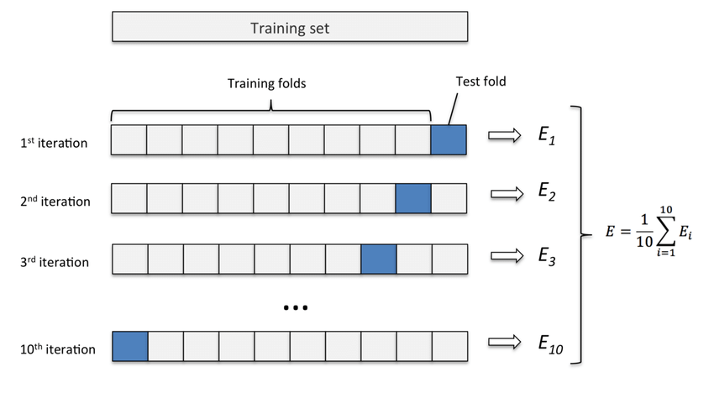
k-fold cross-validation
Randomly partition the training data into K sets of equal size
Run the learning algorithm K times: each time, a different one of the K sets is deemed the test set, and the model is trained on the remaining K-1 sets
The hyperparameter score is the average of the error across the K tests
Pick the best hyperparameters and retrain the model
Ashfaque, Johar & Iqbal, Amer. (2019). Introduction to Support Vector Machines and Kernel Methods.

Slide 48
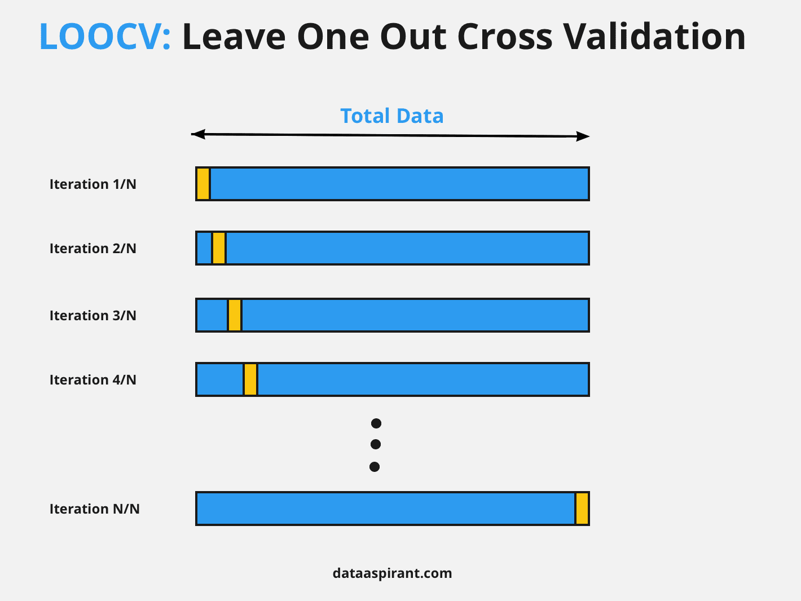
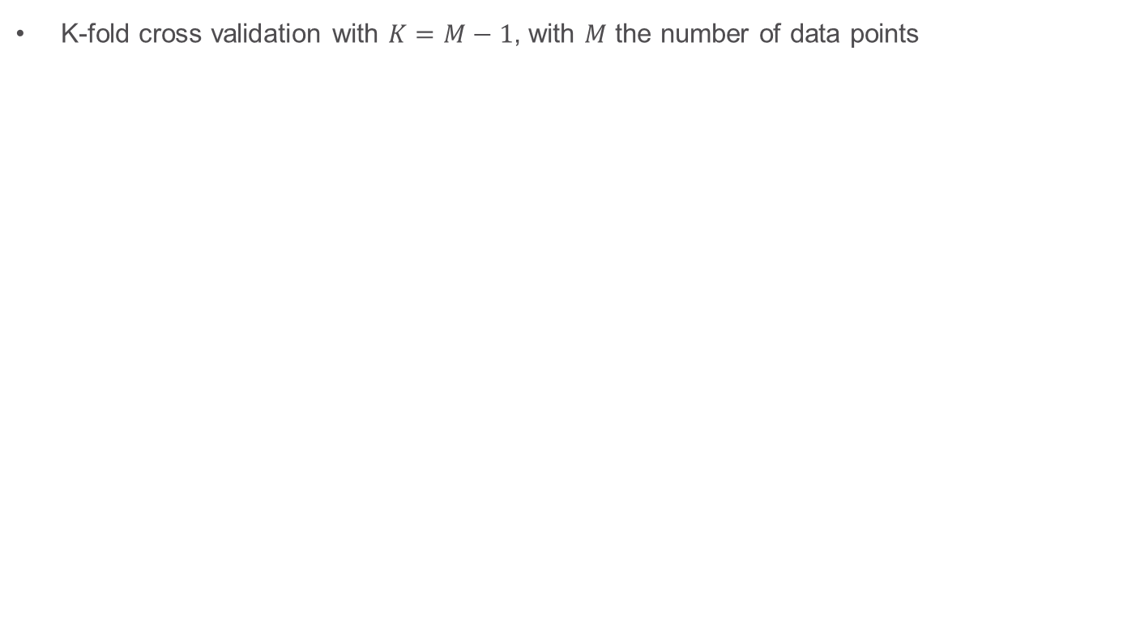
“leave-one-out cross-validation” (LOOCV)
K-fold cross validation with $K=M−1$, with $M$ the number of data points

Slide 49
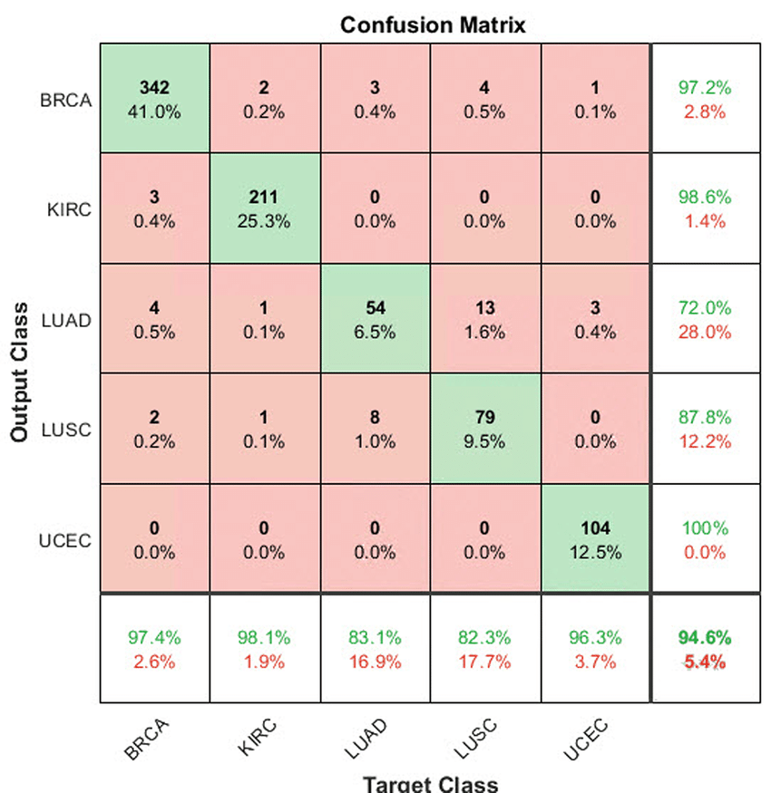
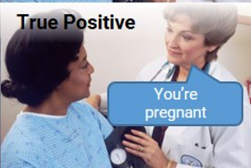
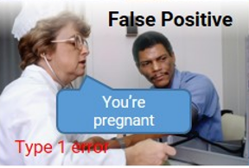
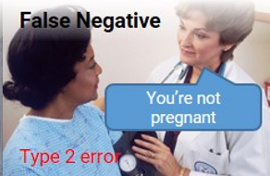
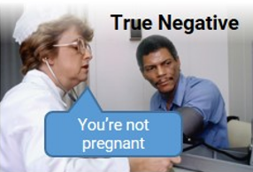
Evaluate a ML algorithm with the confusion matrix
Confusion Matrix: describes the complete performance of the model
True class
Predicted class
 | Positive | Negative
Positive | True positive (TP) | False Positive (FP)
Negative | False Negative (FN) | True Negative (TN)

Slide 50
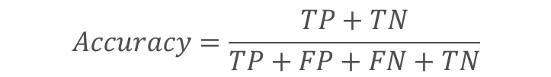
Metrics to evaluate a ML algorithm
Classification Accuracy: ratio of number of correct predictions to the total number of input samples.
$$Accuracy=\frac{TP+TN}{TP+FP+FN+TN}$$
True class
Predicted class
 | Positive | Negative
Positive | True positive (TP) | False Positive (FP)
Negative | False Negative (FN) | True Negative (TN)
Works well if there are equal number of samples belonging to each class.
Notes:
For example, consider that there are 98% samples of class A and 2% samples of class B in our training set. Then our model can easily get 98% training accuracy by simply predicting every training sample belonging to class A.
When the same model is tested on a test set with 60% samples of class A and 40% samples of class B, then the test accuracy would drop down to 60%

Slide 51
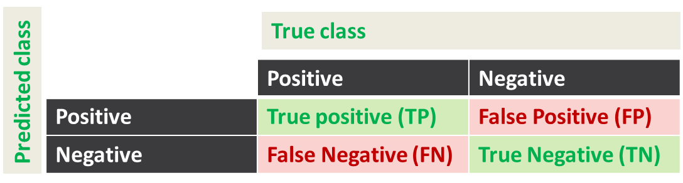
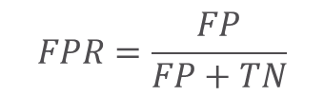
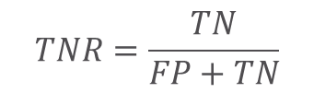
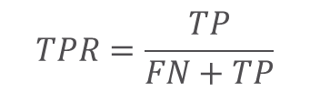
Sensitivity/Recall (proba de detection): True Positive Rate, corresponds to the proportion of positive data points that are correctly considered as positive, with respect to all positive data points.
Specificity: True Negative Rate, corresponds to the proportion of negative data points that are correctly considered as negative, with respect to all negative data points.
False Positive Rate, corresponds to the proportion of negative data points that are mistakenly considered as positive, with respect to all negative data points.
$$TPR=\frac{TP}{FN+TP}$$
Ex: Rapid COVID-19 antigen-test : 97,3% sensitivity
$$TNR=\frac{TN}{FP+TN}$$
Ex: Rapid COVID-19 antigen-test : 100% specificity
For example, if the sensitivity is 100% and the specificity is 50%, this means that all infected people will be detected as positive, however, many people who are not infected will be mistakenly identified as positive (false positives).
$$FPR=\frac{FP}{FP+TN}$$
Notes:
sensibilité : la probabilité que le test soit positif si la maladie est présente, se mesure chez les malades seulement (VP+FN)

Slide 52
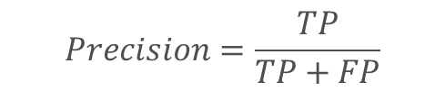
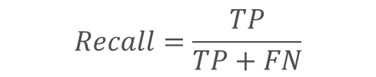
Area Under Curve: the area under the curve of plot False Positive Rate vs True Positive Rate (range [0,1])
Precision: number of correct positive results divided by the number of positive results predicted by the classifier.
F1-score: Harmonic Mean between precision and recall (range [0,1]). It tells you how precise your classifier is (how many instances it classifies correctly), as well as how robust it is (it does not miss a significant number of instances).
$$Precision=\frac{TP}{TP+FP}$$
$$Recall=\frac{TP}{TP+FN}$$

Slide 53
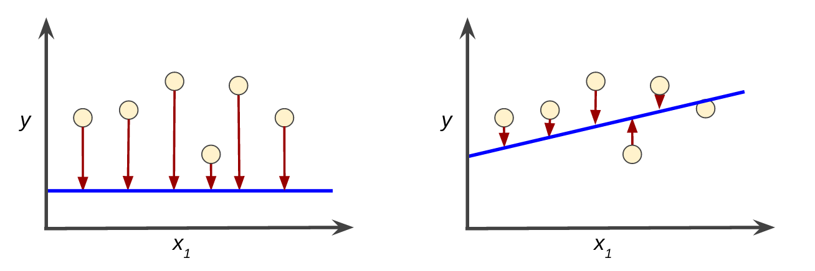
Loss - Intuition
Loss is a number indicating how bad the model's prediction was on a single example.
If the model's prediction is perfect, the loss is zero; otherwise, the loss is greater.
The goal of training a model is to find a set of weights and biases that have low loss, on average, across all examples.
high loss model
low loss model
blue lines represent predictions

Slide 54
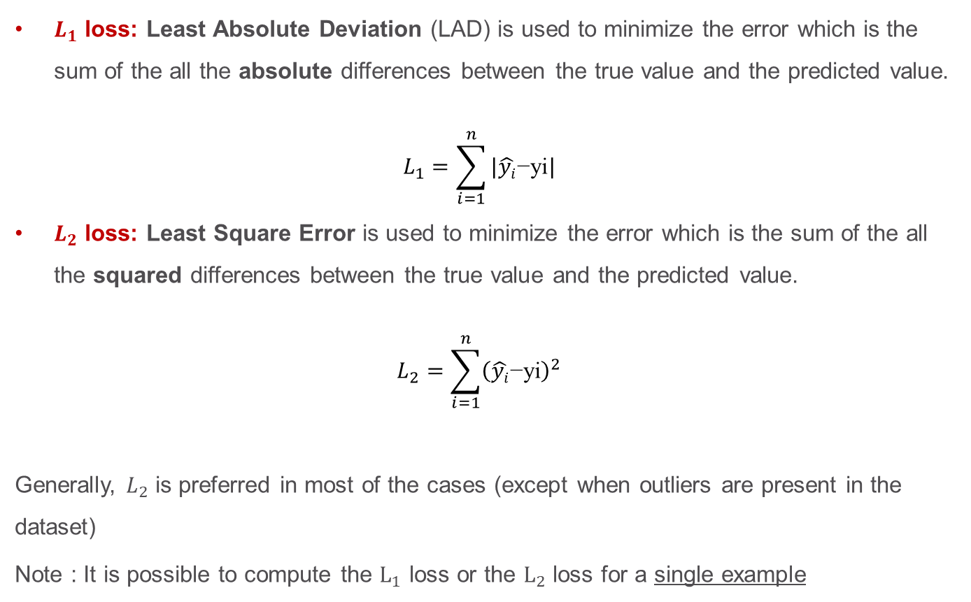
L1 and L2 loss
$L_{1}$ loss: Least Absolute Deviation (LAD) is used to minimize the error which is the sum of the all the absolute differences between the true value and the predicted value.
$$L_{1}=\sum_{i=1}^{n}{{|\hat{yi}\text{−}\text{yi}|}^{}}$$
$L_{2}$ loss: Least Square Error is used to minimize the error which is the sum of the all the squared differences between the true value and the predicted value.
$$L_{2}=\sum_{i=1}^{n}{{{\left(\hat{yi}\text{−}\text{yi}\right)}^{2}}^{}}$$
Generally, $L_{2}$ is preferred in most of the cases (except when outliers are present in the dataset)
Note : It is possible to compute the $L_{1}$ loss or the $L_{2}$ loss for a single example

Slide 55
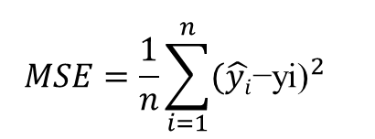



Regression loss functions
Mean Absolute Error (MAE) (empirical $L_{1}$ loss): average of the difference between the original values $\text{yi}$and the predicted values $\hat{y_{i}}$. No info about the direction of the error (under or over prediction)
Mean Squared Error (MSE) Loss (empirical $L_{2}$ loss): takes the average of the square of the difference between the original values and the predicted values. The goal is to reduce MSE
Advantages: easier to compute a gradient, whereas the MAE requires complicated computations
Root Mean Square Error (RMSE)
$${MAE=\frac{1}{n}\sum_{i=1}^{n}{{|\hat{yi}\text{−}\text{yi}|}^{}}}^{}$$
$${MSE=\frac{1}{n}\sum_{i=1}^{n}{{(\hat{yi}\text{−}\text{yi}\text{)}}^{2}}}^{}$$
$${RMSE=\sqrt{\frac{1}{n}\sum_{i=1}^{n}{{(\hat{yi}\text{−}\text{yi}\text{)}}^{2}}}}^{}$$

Slide 56




Binary/Multi-class Classification Loss functions
Binary Cross-entropy: measures the performance of a classification model whose output is a probability value between 0 and 1. Cross-entropy loss increases as the predicted probability value deviates from the actual label. Binary Cross Entropy is the negative average of the log of corrected predicted probabilities.
Log loss: the same but does not computes
corrected probabilities
Binary Cross-Entropy for Multi-class classification, N numbers of rows, M number of classes
$$−\frac{1}{N}\sum_{i=1}^{N}{(\log\left(p_{i}\right))}$$
$$Log loss=\frac{1}{N}\sum_{i=1}^{N}{−(y_{i}\log\left(p_{i}\right)+\left(1−y_{i}\right)log⁡(1−p_{i}))}$$
$$Log loss=−\frac{1}{N}\sum_{i=1}^{N}{\sum_{j=1}^{M}{y_{ij}log(p_{ij})}}$$
https://ml-cheatsheet.readthedocs.io/en/latest/loss_functions.html

Slide 57

iquizz
My model predicts a probability of 0,012 when the actual observation label is 1.
The value of the log loss will be close to 1
The value of the log loss will be greater than 1
The value of the log loss will be close to 0
The value of the log loss will be lower than 0

Slide 58


Other losses
Hinge loss: used for “maximum-margin” classification
For an intended output $y_{i}=±1$ and a classifier score $\hat{y_{i}}$
$$l\left(y_{i},\hat{y_{i}}\right)=\sum_{i=1}^{N}{max⁡(0, 1−y_{i}.\hat{y_{i}}) }$$
Square Hinge loss
$$l\left(y_{i},\hat{y_{i}}\right)=\sum_{i=1}^{N}{{\max\left(0, 1−y_{i}.\hat{y_{i}}\right)}^{2} }$$
Kullback-Leibler Divergence (KL) Loss (relative entropy): it is the expectation of the logarithmic difference between 2 probabilities
For discrete probability distributions P and Q defined on the same probability space, the relative entropy from Q to P is $D_{KL}(P|\left|Q\right)=−\sum_{\left\{x∈𝒳\right\}}{P\left(x\right)log⁡\left(\frac{Q\left(x\right)}{P\left(x\right)}\right) }$
https://towardsdatascience.com/a-definitive-explanation-to-hinge-loss-for-support-vector-machines-ab6d8d3178f1

Slide 59




Bias-variance tradeoff
Bias: Let $T$ be a statistic used to estimate a parameter $θ$. If $E\left(T\right)=θ+b(θ)$⁡ then $b(θ)$ is called the bias of the statistic $T.$ $E\left(T\right)$ represents the expected value of the statistics $T$.
Variance: The variance is the square of the standard deviation $σ,$it can be seen as a measure of dispersion

Slide 60

Overfitting- Underfitting
Attempting to fit the data too carefully leads to overfitting (low bias, high variance)
If the desired output values are often incorrect (human errors or sensor noise), the learning algorithm attempts to find a function that exactly matches the training examples
If the model has too many parameters
Solutions: early stopping, detecting and removing the noisy training examples prior training, smoothness assumption (either with the model directly, or with regularization terms in the optimization criterion)

Slide 61
Overfitting- Underfitting
When a model is not complex enough to accurately capture relationships between features and target variables, it leads to underfitting (high bias, low variance)
Solutions:
Decrease regularization term used to reduce the variance
Increase the duration of training
Feature selection
Increase the size of the model (more hidden neurons, add more trees…)

Slide 62

Supervised learning: a guiding tour

